Slide 1
MS 890 Student and Parent Information Session
September 3rd & 4th

Slide 2
Sign In Please
https://docs.google.com/forms/d/e/1FAIpQLSfBDLtjmVi70C66T55nrlwXQMLcCw-oCk3K3ngCbi-8eW-myA/viewform?vc=0&c=0&w=1&flr=0

Slide 3
Agenda
Opening of the session
Google attendance sheet
Calendar Days/Weeks for Cohort A/B
Classroom by Class
Daily Schedule and Times
Entrance/ Exit and Protocols
Breakfast/ Lunch Times and Protocols
Out Door Class (PE)
Supply List
Student emails Setup
Google Classroom overview
Remote Learners Lunch Link
Requesting Devices
Spark Classes

Slide 4
6th Grade Staff
Matthew Andress – Social Studies
Jennifer Czirr – ICT Math
David Cummings – ICT SS
Daniel Golembe – ICT Science
Audrey Lew – Science
Thomas Masterson – ELA
Louis Muriente – ELA
Simone Kung – Visual Art
Brett Osswald – PhysEd / Health
Candace Rodney - Spanish
Cassandra Ricca – ICT ELA
Diana Russo - Music
Jennifer Strandberg – Math
Dwayne Murray – SE Science/Math
Arwa Alsayhbi – SE ELA / SS

Slide 5
7th Grade Staff
Sumaiya Ahmed - Science
Jennifer Czirr – ICT Math
David Cummings – ICT SS
Daniel Golembe – ICT Science
Dwayne Murray – SE Science/Math
Arwa Alsayhbi – SE ELA / SS
Cassandra Ricca – ICT ELA
Paige Sassu– ELA
Louis Muriente – ELA
Simone Kung – Visual Art
Brett Osswald – PhysEd / Health
Georgia Karantzalis - PhysEd / Health
Candace Rodney - Spanish
Diana Russo - Music
Sandy Rose Rolon– Math
Joseph Sixta – Social Studies

Slide 6
8th Grade Staff
Mohamed Ali- Science
Jennifer Czirr – ICT Math
David Cummings – ICT SS
Daniel Golembe – ICT Science
Dwayne Murray – SE Science/Math
Arwa Alsayhbi – SE ELA / SS
Cassandra Ricca – ICT ELA
Robert Freeman– ELA
Louis Muriente – ELA
Simone Kung – Visual Art
Georgia Karantzalis - PhysEd / Health
Candace Rodney - Spanish
Diana Russo - Music
James Enny– Social Studies
Rachel Zweig – Theater Arts

Slide 7
Paraprofessionals / Teacher Assistants
Jael Aly
Noel Genao
Sarah Gerard
Letice Cox
Rebecca Adelphin

Slide 8
Office & Support Staff
Zahira Manzueta – Secretary
Tricia LoConte – School Aide / Attendance
Nekeisha Bernard – School Aide
Susanna Thomas – School Aide
Gregory Mellon – Psychologist
Cynthia Jerome – Family Worker
Caroline Turner – Guidance Counselor

Slide 9
Contact information
Mr. Frangella (Principal)– nfrangella@schools.nyc.gov 646-926-6396
Ms. Votinelli (AP)– gvotine@schools.nyc.gov
Ms. Lopez (Parent Coordinator) – mlopezurena@schools.nyc.gov
Main Office – 929-397-9200

Slide 10
COVID 19 TESTING
RANDOM MONTHLY TESTING
Staff Testing
10 – 20% of staff and students each month.
Parent consent required. If denied, students will be moved to fully remote learning
Students will be chosen randomly.
Staff getting COVID testing prior to start of student in person arrival on 21st.

Slide 11
COHORT CALENDAR IN PERSON BLENDED LEARNING
Cohort A (Gold team) comes in person Tuesdays, Thursdays and every other Monday
Cohort B (Blue Team) comes in person Wednesdays, Fridays and every other Monday

Slide 12
What if students come on the wrong day?
Students will be given class tags on the first day they arrive that they should wear around their neck. It has their name, class, and cohort color on it (blue or gold).
If a student comes on the wrong day, a parent will be asked to come pick up the student. If you want to give your child written permission to travel home on their own, please sign the form
https://www.ms890.org/uploads/5/9/5/4/59542091/walk_home_incorrect_day_permission_slip.pdf

Slide 14
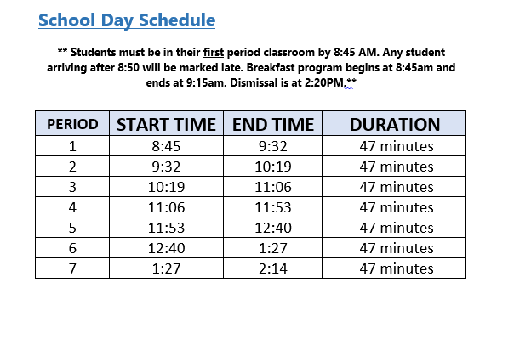

Slide 15
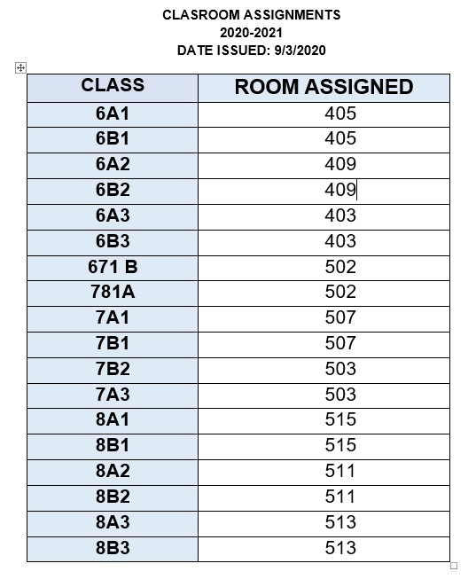
Classroom Assignments

Slide 16
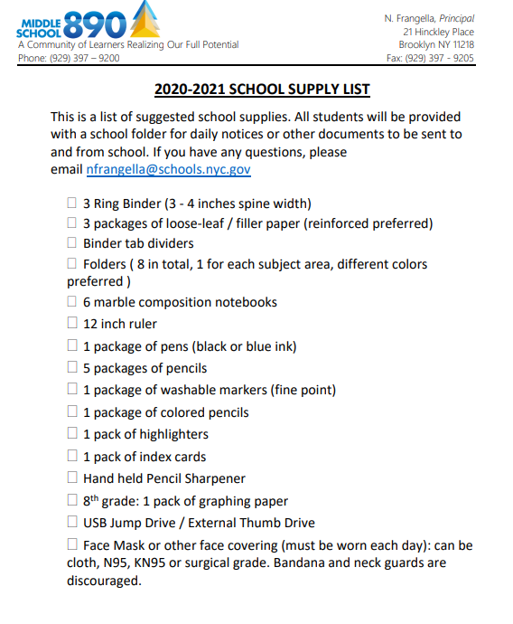

Slide 17
Breakfast
Blended In Person Students
Remote Students
Breakfast Pickup @ 8:45 AM
Breakfast in the classroom period 1
Lunch distributed to class period 4 and 5. (Lunch in classroom)
Students learning 100% remote can pickup breakfast or lunch at the school in the morning from 8:45 to 9:15.
Fill out form to request (forthcoming)

Slide 18
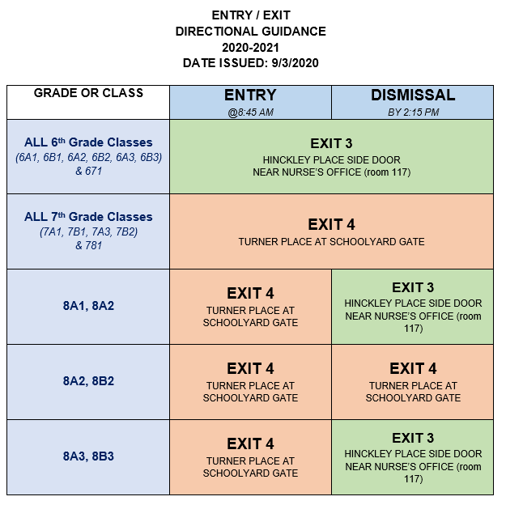

Slide 19
Health Screenings @ Entry
CHECKS AT HOME
RANDOM SCREENING
For students in blended in-person learning, parents are asked to complete a temperature check prior to students arriving in the morning. If your child has fever or is not feeling well, please do not send your child to school.
Every morning, students will be randomly selected to take their temperature. Any student exhibiting a temperature or signs of illness will not be able to enter the building.

Slide 20
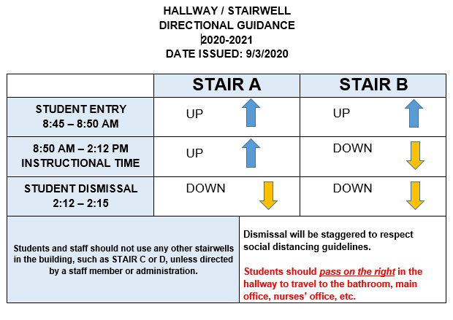

Slide 21
OUTDOOR LEARNING
* Weather permitting and if the schedule allows, certain classes will be able to utilize the outdoor playground/schoolyard for class. This is going to be prioritized for PhysEd classes.

Slide 22
Setting up Student Email
Students will be issued a new NYC Dept of Ed email address for using to access Google Classroom.
Use the link to setup the password for your child’s email address.
Very important! Must be done prior to start of school:
https://idm.nycenet.edu/students/start.form

Slide 23
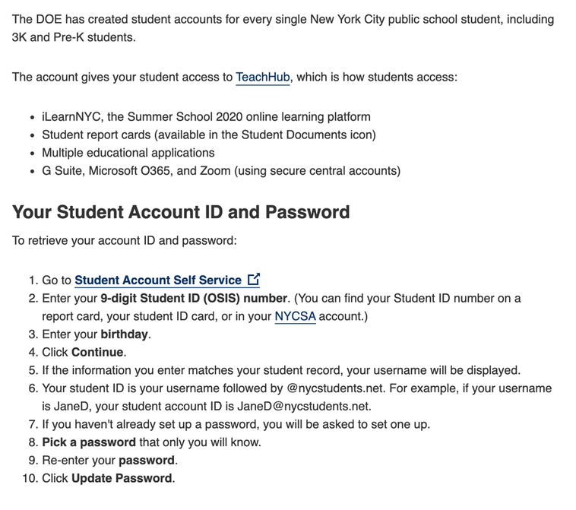
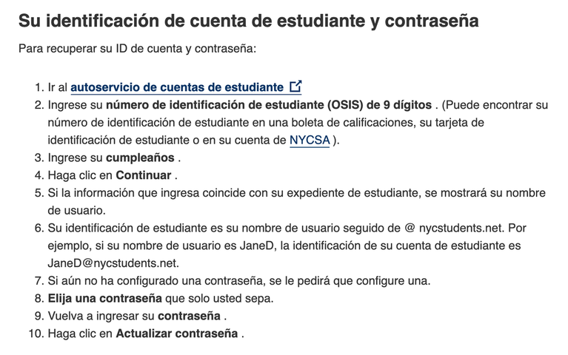

Slide 24
Remote Learning Protocols for Students on Zoom & Google Classroom
Students must be present for the session.
Video should be on so students can be seen.
Students must participate as teacher’s require.
Students should be dressed appropriately.
Students should not be lying down in bed for any session.
Cell phones should be off.
Eating is discouraged for video conferencing.

Slide 25
Information about Google Classroom
https://www.ms890.org/remote-learning.html

Slide 26
Guidance on iPad Requests and Returns
Families can use the DOE Remote Learning Device request form to notify schools of their technology needs.
https://coronavirus.schools.nyc/RemoteLearningDevices
DOE loaned iPads: Families who have iPads should plug in, turn on, and reconnect DOE-loaned devices, as explained on the Getting Started with iPad Page
https://www.schools.nyc.gov/learning/learn-at-home/technical-tools-and-support/getting-started-with-your-ipad

Slide 27
AFTER SCHOOL
Learning Bridges Family Interest Form
For students in grades 3-K–8, who are participating in blended learning, Learning Bridges is a new program that will provide free childcare options on the days when students are scheduled for remote-learning instruction, for the same time period as the remote-learning instructional period. The Learning Bridges programs will:
Be operated by community-based organizations and other partners;
Provide opportunities for children to connect to remote-learning activities;
Include time for art, recreation, and other age-appropriate activities;
Follow the same rigorous health and safety precautions as schools.
Families can express interest in the Learning Bridges program by completing the Learning Bridges family interest form. Please share this information with your families; a flyer will be available on the Early Childhood Summer/Fall Readiness InfoHub page to share with families during the week of August 24.

Slide 28
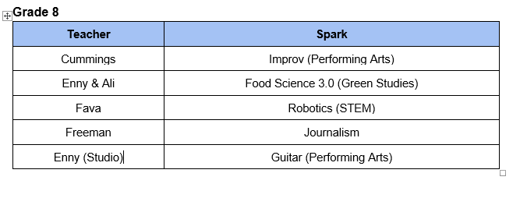

Slide 29
Support School Funding
You do not need to apply for your child to receive meals. However, we do ask families to complete Family Income Inquiry Form which helps schools receive money for their programs: https://www.myschoolapps.com/Home/PickDistrict

Slide 31
Overall Health and Safety Protocols for Every School
At all times, students and staff must wear face coverings protecting their nose and mouth while at school or on their way to school. Exceptions will be made for children who can’t wear a face covering for medical reasons, and for younger children who aren’t developmentally able to wear a face covering.
Students and staff must maintain six feet of physical distancing throughout the school day, anywhere on school grounds and to and from school.
Schools will be cleaned throughout the day and disinfected each night, with special attention to high-touch areas.
Face coverings, hand sanitizer, and cleaning supplies will be readily available in throughout every school.
Every school will have a school-based team ready to respond in the event that there is a health concern in a school.
Every school will have a designated isolation room for use in the event that a student becomes ill during the school day.
For more details on these and other policies, please visit schools.nyc.gov/returntoschool2020 and click “Health and Safety” for additional information and all the latest updates.

Slide 32
The Three Ws
WASH YOUR HANDS
WEAR A MASK
WATCH YOUR DISTANCE

Slide 33
Family Handbook
https://www.ms890.org/student-and-family-handbook.html

