Slide 1
Editing Techniques
Objective: I will be able to use editing techniques to create meaning in my short film.

Slide 2
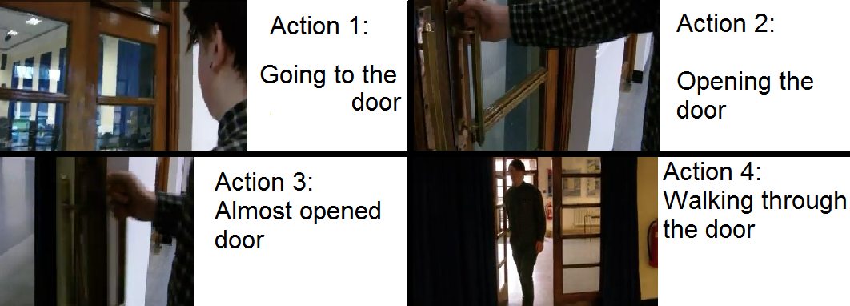
Cutting in Action/ Standard Cut
Having the action of a scene play out in order.
In the editor, just do it by putting two clips together in the timeline.

Slide 3
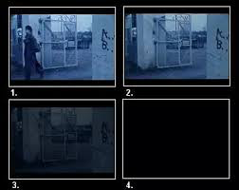
Fade In/Out
A slow dissolve at the beginning or ending of a clip. Used for: ending or beginning a new scene that takes place in a new location.

Slide 4
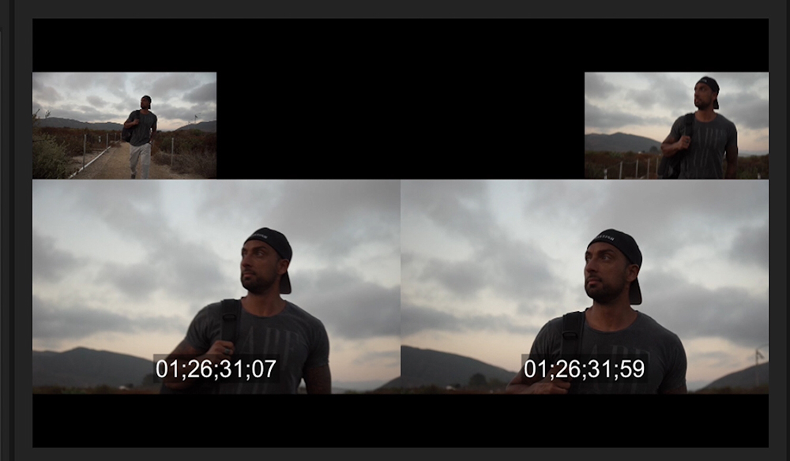
Jump Cut
Cutting out the pieces of a clip to make the time SEEM like it goes faster.
USED For: Show a long sequence of events in a shot period of time.
Guy “jumps” from walking on the start of the bridge to middle of bridge.

Slide 5
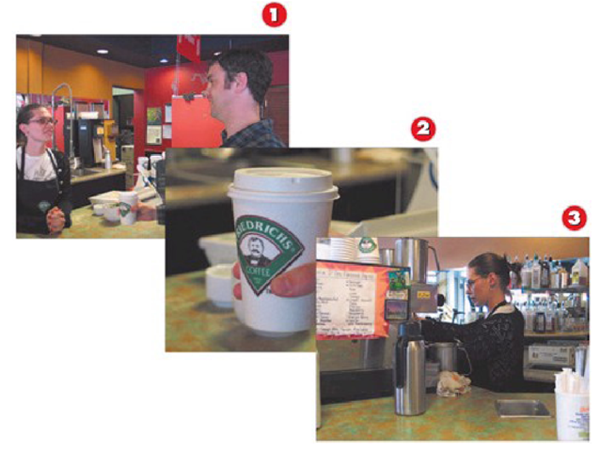
Cutaway Shot
In a film or video, a cutaway or a cutaway shot is a picture that shows something different from the main thing that is being shown.

